Slide 1

Child Care in the NYS Budget:
Where Things Stand As We Enter
The Final Stretch of Negotiations
March 20, 2024

Slide 2
What We Want!
We are fighting for a high-quality, free, equitable, and universal child care system that meets the needs of all children and families and pays child care programs the true cost of care, with a thriving wage and benefits.

Slide 3
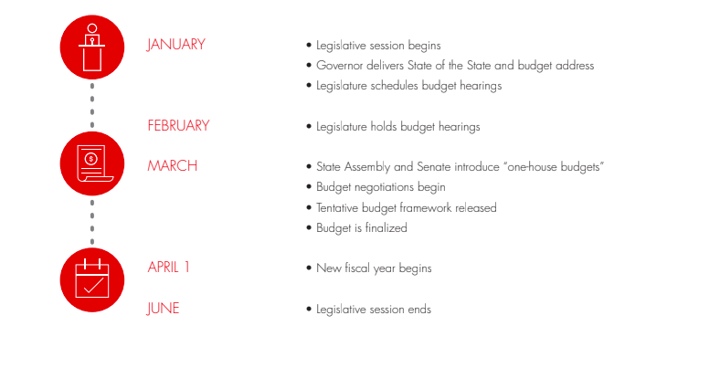
NYS Budget Season: Final Sprint!

Slide 4
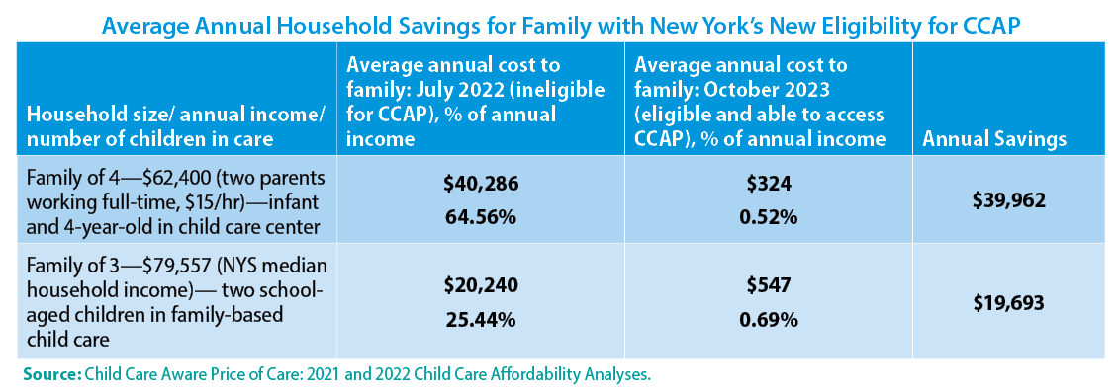
New York has made historic expansions to child care assistance since 2022
Notes:
Child care assistance – principal means of public help to offset the high costs of child care. The state’s eligibility expansions are since July 2022 can’t be overstated. Then, income eligibility was capped at 200% of FPL ($55,000 for a family of 4); as of Oct 2023, 85% of SMI - $99,250 for a family of 4. More than 300,000 children newly income eligible. Look at the impacts on family finances.

Slide 5
Our advocacy is working!
New York’s total investment in child care assistance has nearly doubled in the last five years; the state’s investment has quadrupled
FY 2020 Enacted Budget | FY 2025 Executive Proposal
$832 million (total subsidies) | $1.78 billion (total subsidies)
$182.8 million (state funds) | $863 million (state funds)
Notes:
State investment up by 50% from last year - $459 last year; Executive this year proposing $863

Slide 6
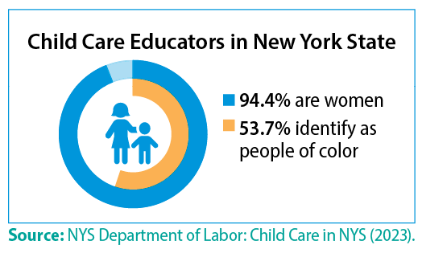
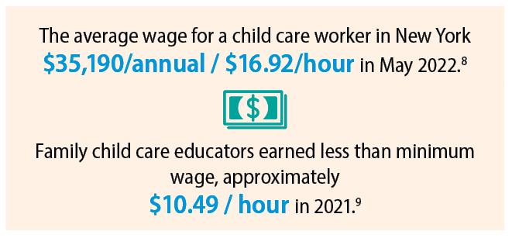
But more to be done. First priority: workforce!
Notes:
Without a well-supported, steady, reliable workforce, all of the gains of the last two years are in jeopardy and the state’s stated goal of moving toward universal child care – an impossibility. Being eligible for child care assistance means nothing if a family cannot find a child care provider in their community, able to care for their child, during the hours they need care. Providers cannot operate at full capacity / serve all the families that need care, b/c they cannot find and retain staff without raising wages, and they cannot raise wages, unless they raise tuition. And with parents already paying more than they can afford, raising tuition is not an option.
Pete- does the Executive Budget address the child care workforce issue?

Slide 7
The Executive Budget if passed would result in a cut to child care workforce compensation
This year’s Executive Budget contains NO new funds for the child care workforce. It calls for OCFS to distribute the remaining federal funds – to the applicants approved last year.
If the Executive Budget stands, child care educators will at best, receive a one time bonus that is about 50% less than the bonus they received last year
Senate and Assembly have proposed $220 million in state funds to add to the existing workforce retention fund – they are hoping for a total of $500 million.
Notes:
The only way to raise child care workforce compensation without charging parents more is to provide a publicly-funded wage supplement
Last year’s budget included $500 million of reprogrammed federal pandemic funds for workforce retention and recruitment grants.
75,000 child care educators received a retention bonus of $3,000 for full-time child care educators; $2300 for afterschool (totaling $337,387,338).

Slide 8
Executive proposal | Senate Proposal | Assembly Proposal
NO new funds for the child care workforce. It calls for OCFS to distribute the remaining federal funds $280 million – to the applicants approved last year. | $220 million in state funds to add to the existing workforce retention fund – they are hoping for a total of $500 million. In resolution they call for fund to be permanent. | $220 million in state funds to add to the existing workforce retention fund – they are hoping for a total of $500 million.

Slide 9
Workforce: What we need
Create a permanent state-funded child care wage equity fund; provide annual wage supplements to all members of the workforce of $12,500 ($1.2 billion)
  Senate in their resolution indicates the funds should establish “a permanent Workforce Retention Grant Program.” Must be in statute!
Notes:
Increase rates for family friend and neighbor child care providers (legally-exempt) to 75% of the family child care rate and to 85% for providers who are eligible for the enhanced to raise compensation for these providers. ($50 million)

Slide 10
Knock down barriers that keep many families that need child care most from accessing assistance
Decoupling. End NY’s practice of tying child care access to parents’ exact hours of work.
  Adopt Senate and Assembly’s proposal
Preserve and expand the new Facilitated Enrollment Scholarship Programs which provide assistance to families ineligible for other types of child care assistance including children excluded due solely to their immigration status.
  Adopt the Senate proposal to invest $10 million, an expansion of $5.5 million
Commit NYS to use a cost estimation model to determine state child care reimbursement rates by 2025 ($250,000).
  Adopt the Assembly proposal

Slide 11
Call To Action!
Hello, my name is ___________, and I'm a New Yorker who believes that New York State must step up and address the child care crisis by creating a permanent compensation fund of $1.2 billion in this year's budget to raise the wages of child care providers. The key to a thriving economy or family stability is paying the child care workforce.
Governor Hochul: (518) 474-8390
Majority Leader Stewart-Cousins: (518) 455-2715
Speaker Heastie: (518)455-3791

