Slide 1

Child Care is Essential!
How We Can Make Child Care Work for All New Yorkers
March 6, 2024
Empire State Campaign for Child Care

Slide 2
New York Child Care: The Basics
NYS is home to 4,128,443 children under age 18; more than one million are under the age of 5
69% of NYS children (834,000) under the age of 6 have all available parents in the workforce
Child care is the largest monthly bill for many NY families costing an average of $3,357 per month ($40,286 per year) for an infant and 4-year old in a child care center
107,386 children on Child Care Assistance in Dec. 2023 (7% of families who are income eligible for child care assistance are actually receiving it)

Slide 3
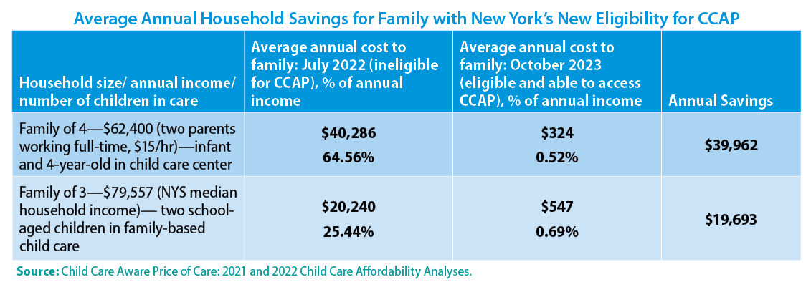
New York has made historic expansions to child care assistance since 2022
Notes:
Child care assistance – principal means of public help to offset the high costs of child care. The state’s eligibility expansions are since July 2022 can’t be overstated. Then, income eligibility was capped at 200% of FPL ($55,000 for a family of 4); as of Oct 2023, 85% of SMI - $99,250 for a family of 4. More than 300,000 children newly income eligible. Look at the impacts on family finances.

Slide 4
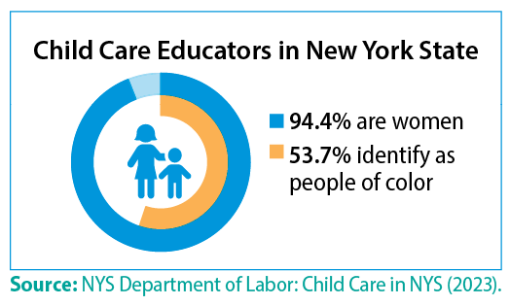
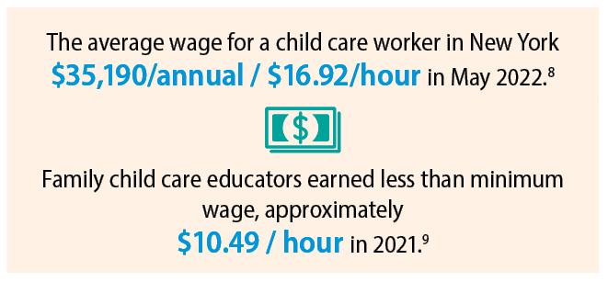
Child care staffing shortages due to low wages have contributed to New York’s child care capacity challenges
Notes:
Without a well-supported, steady, reliable workforce, all of the gains of the last two years are in jeopardy and the state’s stated goal of moving toward universal child care – an impossibility. Being eligible for child care assistance means nothing if a family cannot find a child care provider in their community, able to care for their child, during the hours they need care. Providers cannot operate at full capacity / serve all the families that need care, b/c they cannot find and retain staff without raising wages, and they cannot raise wages, unless they raise tuition. And with parents already paying more than they can afford, raising tuition is not an option.
Pete- does the Executive Budget address the child care workforce issue?

Slide 5
The Executive Budget will result in a cut to child care workforce compensation
Last year’s budget included $500 million of reprogrammed federal pandemic funds for workforce retention and recruitment grants.
75,000 child care educators received a retention bonus of $3,000 for full-time child care educators; $2300 for afterschool (totaling $337,387,338).
This year’s Executive Budget contains NO new funds for the child care workforce. It calls for OCFS to distribute the remaining federal funds – approximately $162 million – to the applicants approved last year.
If the Executive Budget stands, child care educators will at best, receive a one time bonus that is about 50% less than the bonus they received last year
Notes:
The only way to raise child care workforce compensation without charging parents more is to provide a publicly-funded wage supplement

Slide 6
Workforce: What we need
Create a permanent state-funded child care wage equity fund; provide annual wage supplements to all members of the workforce of $12,500 . ($1.2 billion)
Increase rates for family friend and neighbor child care providers (legally-exempt) to 75% of the family child care rate and to 85% for providers who are eligible for the enhanced to raise compensation for these providers. ($50 million)

Slide 7
Knock down barriers that keep many families that need child care most from accessing assistance
Decoupling. End NY’s practice of tying child care access to parents’ exact hours of work, effectively barromg many working parents in the gig economy, or in retail with fluctuating schedules from assistance. (S.5327A/ A.4986A) ($70 million).
Preserve and expand the new Facilitated Enrollment Scholarship Programs which provide assistance to families ineligible for other types of child care assistance including children excluded due solely to their immigration status.
  $5 million for NYC – up from $1.4M last year, to serve 275 more children
  $5 million, up from $4 million last year
  Re-appropriate last year’s allocation to these programs to enable initial recipients to receive a full 12 months of scholarship funding.
Commit NYS to use a cost estimation model to determine state child care reimbursement rates by 2025 ($250,000).

Slide 8
Call To Action!
Hello, my name is ___________, and I'm a New Yorker who believes that New York State must step up and address the child care crisis by creating a permanent compensation fund of $1.2 billion in this year's budget to raise the wages of child care providers. The key to a thriving economy or family stability is paying the child care workforce.
Governor Hochul: (518) 474-8390
Majority Leader Stewart-Cousins: (518) 455-2715
Speaker Heastie: (518)455-3791

